Slide 1
Cryptanalysis of Caesar using Quantum Support Vector Machine
Hyun-Ji Kim, Gyeong-Ju Song, Kyung-Bae Jang, Hwa-Jeong Seo

Slide 2
Introduction
Background
Proposed Method
Evaluation
Conclusion

Slide 3
Introduction

Slide 4
Motivation and Contribution
Motivation
Recently, research on deep learning-based cryptanalysis has been conducted.
With the development of quantum computers, quantum artificial intelligence technology has also been developed.
→ Let's do cryptanalysis using a quantum computer.
Contribution
Cryptanalysis method on a quantum computer using QSVM for Caesar cryptography.
Experiments using real quantum hardware.

Slide 5
Background

Slide 6
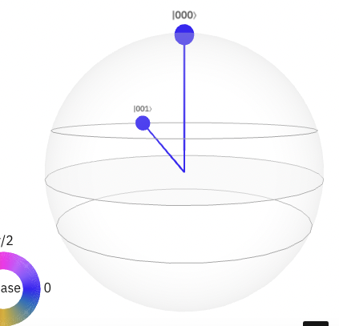
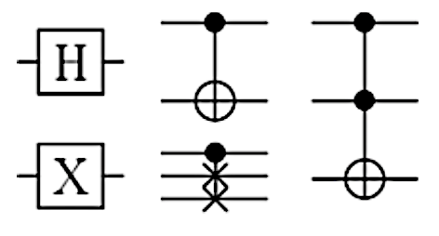


Quantum Circuits
Use qubits and quantum gates (like bit and gate of classical logic circuits) → Based on the principles of quantum mechanics. (superposition and entanglement)
Qubits
Through the superposition state, all values exist as probabilities.
Determined as a single value when observed.
One logical qubit (without an error), several physical qubits are required.
Quantum gates
Control the state of qubits.
Gates such as Hadamard, NOT, CNOT, SWAP with superposition and entanglement exist.
$$0$$
$$1$$
Classic bit
Qubit
Quantum gates

Slide 7
Support Vector Machine
SVM
One of the supervised machine learning algorithms → Finds the optimal boundary between data points through a hyperplane.
Hyperplane
𝑛 − 1 dimensional and is used to separate the 𝑛-dimensional space.
Kernel
Arranges various hyperplanes so that the data points can be divided well. → To separate data points.
Feature map
To find the hyperplane, a nonlinear function (polynomial, gaussian, and sigmoid functions) must be applied to the data.

Slide 8
Quantum Support Vector Machine
QSVM
Performs the kernel operation of classical SVM on a quantum computer → proceeds in the same way as the existing process.
Advantages
Good for working with more dimensional data
Benefits for kernel optimizations, which are difficult for SVMs to handle
Generally, outperforms classical SVM

Slide 9
Proposed Method

Slide 10
Proposed Method
A cryptanalysis on a quantum computer using QSVM for Caesar cryptography.
Known-plaintext attack → Finds the used key through a pair of plaintext and ciphertext.
Input Data PT||CT
Data encoding, Run quantum circuit
Measure class
key
Dataset for Known-plaintext attack
Quantum Support Vector Machine
Determine the state of a qubit as a single value

Slide 11
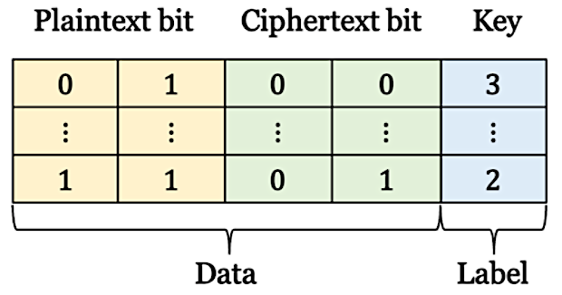
Proposed Method - Dataset
Known-plaintext attack → Finding the secret key value while the attacker has access to both plaintext and ciphertext → plaintext || ciphertext
Each plaintext and ciphertext (Input) → Represented by bits or float type.
Key (Output) → To be used as a label, so it is represented as a decimal number.

Slide 12
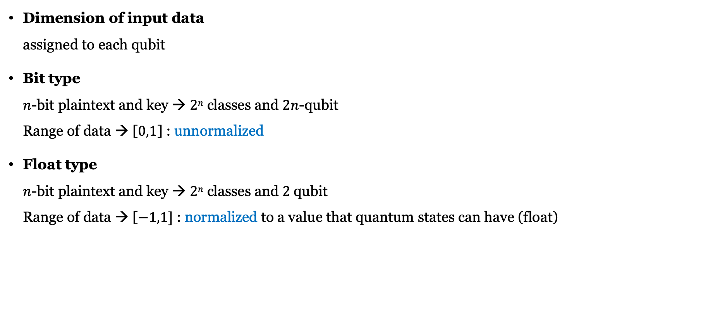
Proposed Method - Dataset
Dimension of input data assigned to each qubit
Bit type $n$-bit plaintext and key → $2n$ classes and $2n$-qubit Range of data → [$0,1$] : unnormalized
Float type $n$-bit plaintext and key → $2n$ classes and $2 \text{qubit}$ Range of data → [$−1,1]$ : normalized to a value that quantum states can have (float)
Notes:
0,1을 평면에 나타낸거랑
숫자 자체를 -1~1사이값으로 한 거랑..
아마 논문 그림이 잘못된듯 ㄷ ㄷ

Slide 13
Proposed Method – Quantum circuit
Data encoding The process of transforming classical data into a quantum state.
So, the input data is expressed as a parameterized quantum circuit. → The parameters of the quantum circuit are affected by the input data.
Design a quantum circuit that includes non-linear operations → To perform non-linear operations of QSVM. → The quantum circuits become the kernel of QSVM.
Training and classification are possible by repeatedly running the circuit.

Slide 14
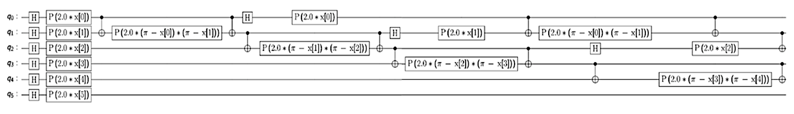

Proposed Method – Quantum circuit
Feature map (ZZFeatureMap) → Quantum entanglement possible (Using controlled qubit, linear option), Second-order
Currently, no gates are provided to express the formula representing this feature map. → So, the feature map uses a combination of gates for nonlinear function. (Hadamard, CNOT, and rotation around Z axis, etc.)
Linear option of entanglement → since the circuit depth is smaller, the execution time is shorter. → higher accuracy can be obtained due to less depth
$$⋯$$
Notes:
3개중 Zz 로 한 이유?
회로깊이, 양자게이트 종류, 데이터 인코딩위한 부분 고려해야함
얽힘 상태 필요 (게이트 종류)
1차 이상이라 zz
파울리는 사용자 정의인데 왜 안썻냐하면?
Zz가 기본 회로이고 이 이상 더 추가적인 게이트 같은 요소가 필요없을거같아서.

Slide 15
Proposed Method
Training
By repeatedly executing the designed quantum circuit, the parameters of the circuit are updated.
Measurements are performed on each qubit. → To determine the state of the qubit with a single value → Performed multiple times to classify them with high probability.
Classification
The trained quantum circuit can act as a classifier.
When test data is input, the inference is performed.

Slide 16
Evaluation

Slide 17
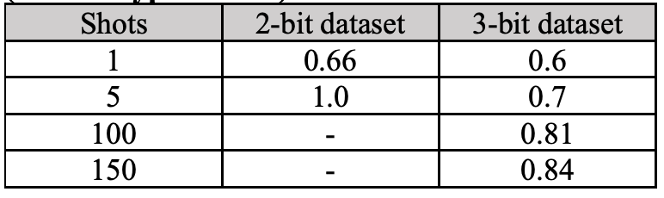
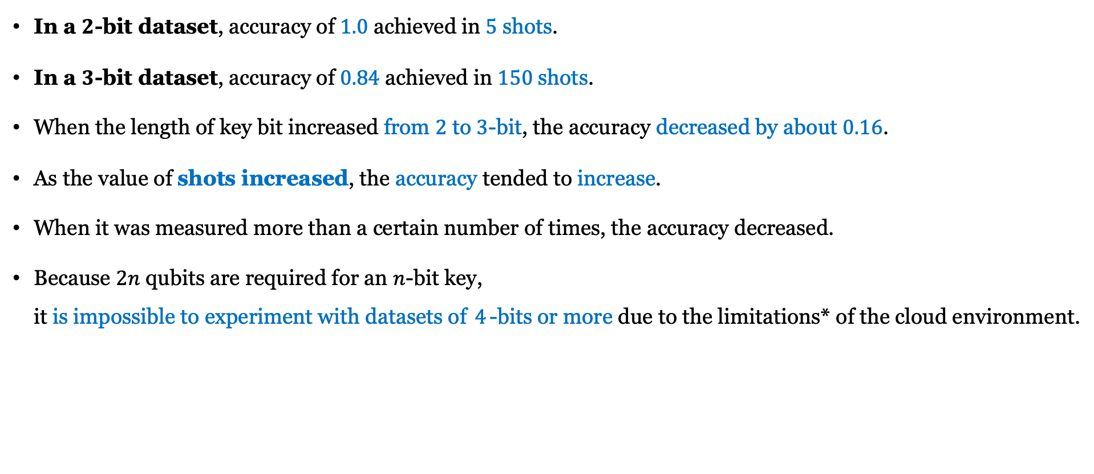
Accuracy of bit type dataset
In a $2$-bit dataset, accuracy of $1.0$ achieved in $5$shots.
In a $3$-bit dataset, accuracy of $0.84$ achieved in $150$shots.
When the length of key bit increased from $2$ to $3$-bit, the accuracy decreased by about $0.16$.
As the value of shots increased, the accuracy tended to increase.
When it was measured more than a certain number of times, the accuracy decreased.
Because $2n$ qubits are required for an $n$-bit key, it is impossible to experiment with datasets of $4$-bits or more due to the limitations* of the cloud environment.
Accuracy of bit type dataset
*runtime shutdown and RAM usage exceeded

Slide 18
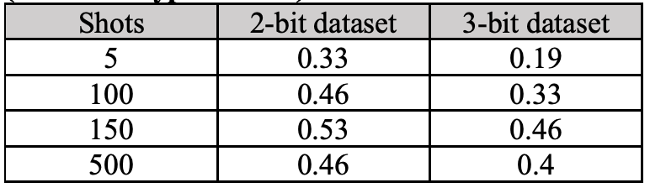

Accuracy of float type dataset
After expressing the hexadecimal plaintext and the ciphertext in decimal, the data set of the float type was constructed by normalizing it to a value between -1 and 1.
Only $2$-qubit is required even if the size of the plaintext and key increases.
The classification performance is worse than bit type dataset.
Accuracy of float type dataset

Slide 19
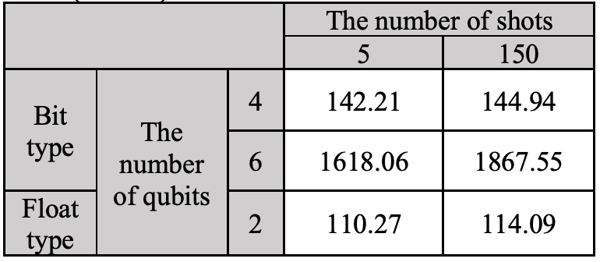
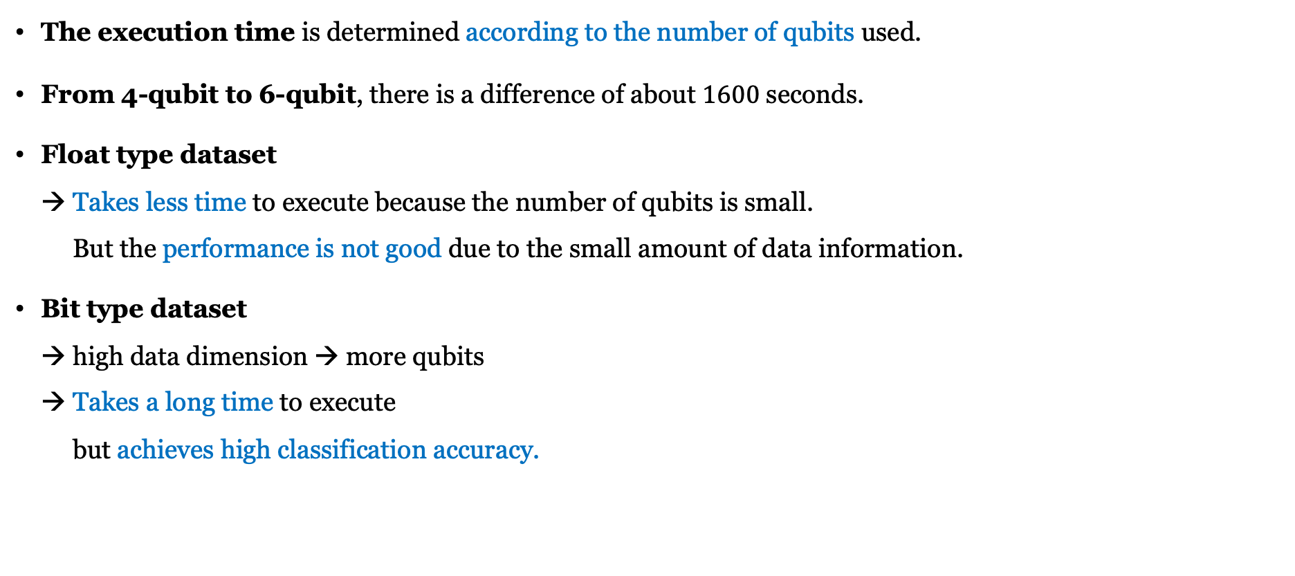
Execution time according to qubits and shots
The execution time is determined according to the number of qubits used.
From 4-qubit to 6-qubit, there is a difference of about $1600$ seconds.
Float type dataset → Takes less time to execute because the number of qubits is small. But the performance is not good due to the small amount of data information.
Bit type dataset → high data dimension → more qubits → Takes a long time to execute but achieves high classification accuracy.
Execution time according to qubits and shots. (unit : s)
Notes:
근데 입력 차원이 적으면 오히려 더 좋은 거 아니었나??? 아니 회로 뎁스랑 관련잇엇음.

Slide 20
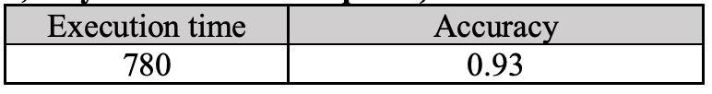

Execution time and accuracy on real quantum hardware
Used real hardware : 'ibmq_bogota’ → provides $5$-qubits and $32$ quantum volumes.
$780$seconds ($5.5$ times longer than the simulator)
Accuracy decreased by $0.07$ → due to errors such as noise generated in the operation process in the real processor.
Execution time and accuracy on real quantum hardware (unit : s / the number of shots : $5$ (best case) / only $2$-bit dataset : $4$-qubits)

Slide 21
Conclusion

Slide 22
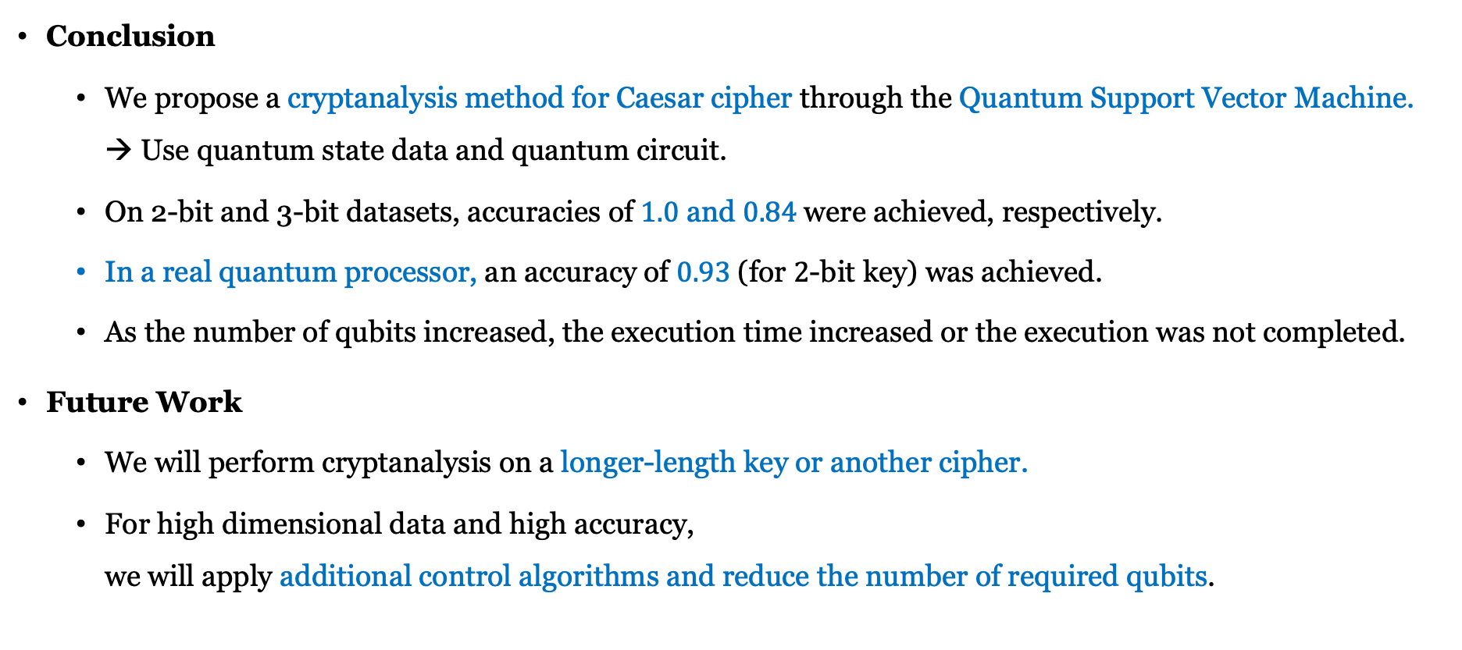
Conclusion
Conclusion
We propose a cryptanalysis method for Caesar cipher through the Quantum Support Vector Machine. → Use quantum state data and quantum circuit.
On 2-bit and 3-bit datasets, accuracies of $1.0$ and $0.84$were achieved, respectively.
In a real quantum processor, an accuracy of $0.93$(for $2$-bit key) was achieved.
As the number of qubits increased, the execution time increased or the execution was not completed.
Future Work
We will perform cryptanalysis on a longer-length key or another cipher.
For high dimensional data and high accuracy, we will apply additional control algorithms and reduce the number of required qubits.

Slide 23
Thank you for your attention.

